Slide 1
Text Summarization
Done By:
18K41A04B4
18K41A0450
18K41A0595
18K41A05F3

Slide 2
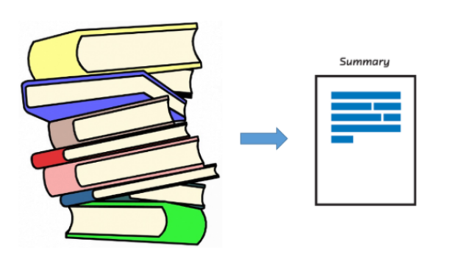
Introduction
Text summarization refers to the technique of shortening long pieces of text.
The intention is to create a coherent and fluent summary having only the main points outlined in the document.

Slide 3
Importance of text Summarization
Can get maximum information by spending minimum time from unstructured textual data.
To enhance the readability of the documents.
Can eliminate redundant, insignificant text and provide required information
Accelerates the process of researching for information
It reduces the reading time
Helps in better research work
Increases the amount of information that can fit in an area.

Slide 4
Types of Text summarization
Extractive based Summaries
Abstractive based Summaries

Slide 5
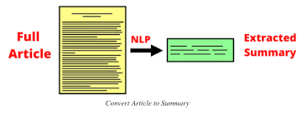
Extractive based summaries
Content is extracted from the original data, but the extracted content is not modified in any way.
In Simple words we identify the important sentences or key — phrases from the original text and extract only those from the text.
Most of the Summarization research today based on Extractive Summary

Slide 6
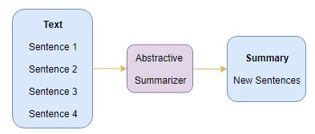
Abstractive based Summaries
Requires deep understanding and reasoning over the text
In this the summary of the texts can be different from original text, which is contrast to extraction based summarization where which used only existing sentences that were present.
It provides own summary over input text without using the same word or sentence in
the input text
Determines the actual and short meaning of each element, such as words, sentences and paragraphs

Slide 7
Data Set
We take data from internet which consists of News articles for making extractive based summarization
We can also use novels or story books which consists of maximum pages as a dataset for making extractive based summarization
We can also use information of particular topic from Wikipedia as a dataset for extractive based summarization

Slide 8
Methodology used
Natural Language Tool Kit
It is a leading platform for building python programs to work with human language data
NLP is a field of computer science , artificial intelligence and linguistic processing
It provides suite of text processing libraries for Classification, tokenization, stemming, tagging, parsing and semantic reasoning
It also includes graphical demonstrations and sample data sets as well as accompanied by a cook book and a book which explains the principles behind the underlying language processing tasks that NLTK supports.

Slide 9
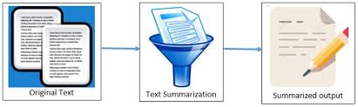

Slide 10
Main steps for text summarization:
There are three main steps for summarizing documents.
These are topic identification, interpretation and summary generation.
Topic Identification : The most prominent information in the text is identified .
There are different techniques for topic identification are used which are Position, Cue Phrases, word frequency. Methods which are based on the position of phrases are the most useful methods for topic identification.
Interpretation : Abstract summaries need to go through interpretation step.
In This step, different subjects are fused in order to form a general content.
Summary Generation : In this step, the system uses text generation method

Slide 11
Steps involved in text summarization
1) Data collection from Wikipedia using web scraping(using Urllib library)
2) Parsing the URL content of the data(using BeautifulSoup library)
3) Data clean-up like removing special characters, numeric values, stop words and punctuations.
4) Tokenization — Creation of tokens (Word tokens and Sentence tokens)
5) Calculate the word frequency for each word.
6) Calculate the weighted frequency for each sentence.
7) Creation of summary choosing 30% of top weighted sentences.

Slide 12
Applications of text summarization
Summaries of email threads
Action items from a meeting
Simplifying text by compressing Sentences
Text summarization can be used by personal or specialized assistants, that would be the ultimate use case.
Apart from that it can be used for many personalized devices or applications. Mail clients, report generation, news feed etc.

Slide 13
conclusion
Automated summarization is an important area in NLP (Natural Language Processing) research.
It consists of automatically creating a summary of one or more texts.
The purpose of extractive document summarization is to automatically select a number of indicative sentences, passages, or paragraphs from the original document .
Text summarization approaches based on Neural Network, Graph Theoretic, Fuzzy and Cluster have, to an extent, succeeded in making an effective summary of a document.

Slide 14
THANK YOU

